Slide 1

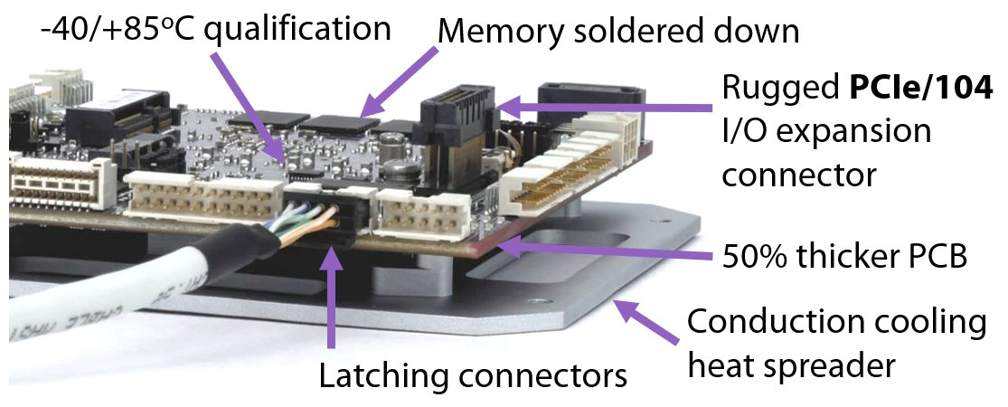
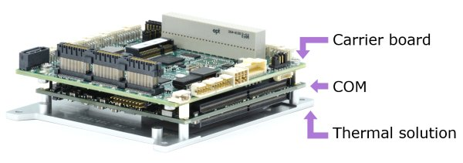
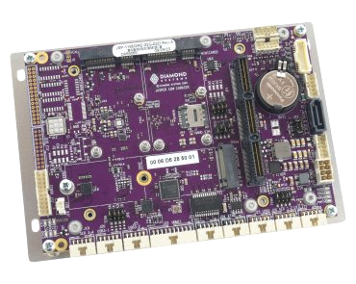

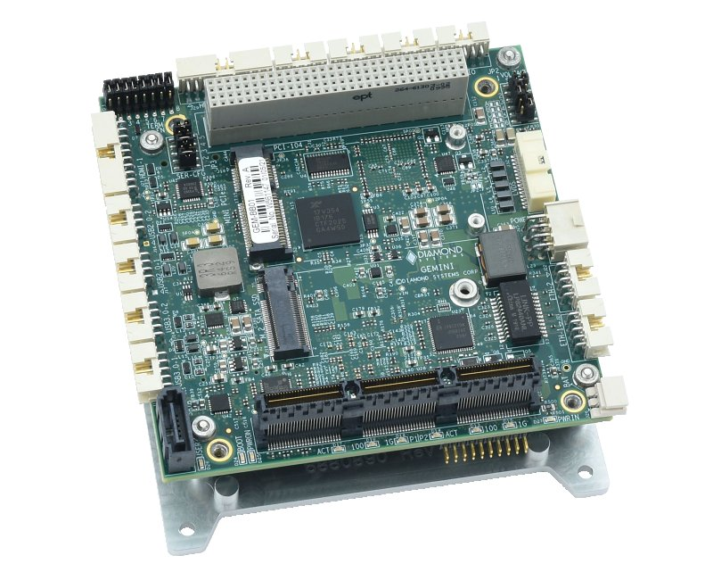
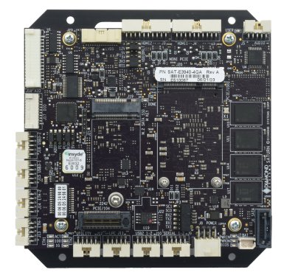
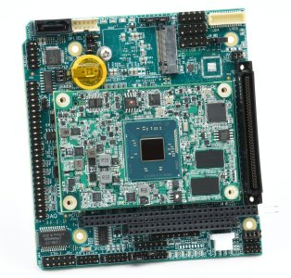
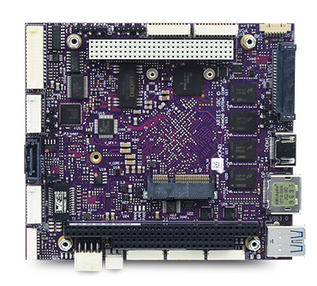
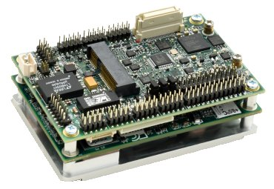
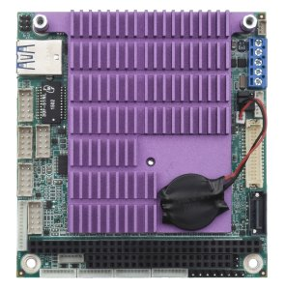

EMBEDDED COMPUTERS
Diamond Systems offers a range of single-board computers based on x86 technology designed specifically for the rigors of industrial and military applications. Our SBCs offer numerous features and benefits for embedded applications:
COM-based design - our COM-based SBCs feature performance scalability and extendd lifecycle by enabling quick changeover to a new COM if the processor reaches end of life.
Rugged - All boards -40 to +85ºC operation. Products feature thicker PCBs and latching I/O connectors. Many products are qualified to MIL-STD-202H shock & vibration.
Product | CPU / RAM | Display | I/O | DAQ | Expansion | Size
 | i7-1185GRE 32GB i7-1185G7E 64GB I7-1365URE 64GB Xeon 11865MRE 96GB | 2 HDMI24-bit LVDS | 2 GbE 2 USB 3.1 2 USB 2.0 4 RS-232 /422/485 | 16 16-bit A/D 4 16-bit D/A 22 GPIO | PCIe/104 2x Minicard | 3.775 x 3.75” 96 x 90mm
 | i7-1185GRE 32GB i7-1185G7E 64GB | 2 HDMI 24-bit LVDS | 2 GbE 2 USB 3.0 4 USB 2.0 4 RS-232/ 422/485 | 8 GPIO | PCI/104-Express (PCI + PCIe) Minicard | 4.0 x 4.0” 102 x 102mm
 | x7-E3950 4GB | 2 HDMI 24-bit LVDS | 2 GbE 2 USB 3.0 2 USB 2.0 3 COM | 16 16-bit A/D 4 16-bit D/A 22 GPIO | PCIe/104 Minicard | 4.8 x 4.5” 122 x 114mm
 | x7-E3950 4GB x7433RE 16GB x7835RE 16GB | VGA 24-bit LVDS | 2 GbE 1 USB 3.0 4 USB 2.0 4 RS-232 /422/485 | 16 16-bit A/D 4 12-bit D/A 24 GPIO | PC/104 | 4.5 x 4.2” 114 x 106mm
 | BT E3845 4GB | VGA 24-bit LVDS | 2 GbE 1 USB 3.0 3 USB 2.0 4 RS-232 /422/485 | 16 16-bit A/D 4 16-bit D/A 22 GPIO | PC/104-Plus (PCI + ISA) Minicard | 4.0 x 4.5” 102 x 114mm
 | x7-E3950 4GB x7433RE 16GB x7835RE 16GB | VGA 24-bit LVDS | 2 GbE 1 USB 3.0 4 USB 2.0 4 RS-232 /422/485 | 16 16-bit A/D 4 16-bit D/A 27 GPIO | Minicard Daughterboard connector with PCIe | 2.2 x 3.3” 55 x 84mm
 | BT E3845 4GB | VGA 24-bit LVDS | 2x GbE 1x USB 3.0 2x USB 2.0 4x COM | 8 GPIO | PC/104 Minicard | 3.775 x 3.55” 96 x 90mm PC/104
Jasper
Gemini
Saturn
Athena IV
Performance
Upgrade!
Aries
Zeta
Performance
Upgrade!
Tiny!
Samson
© 2025 Diamond Systems Corp.
www.diamondsystems.com

Slide 2
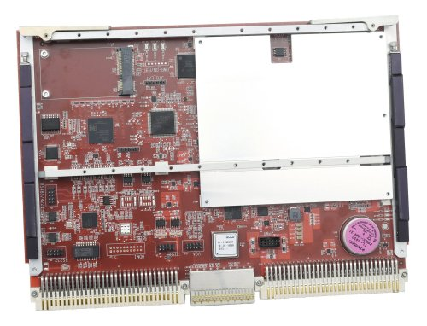
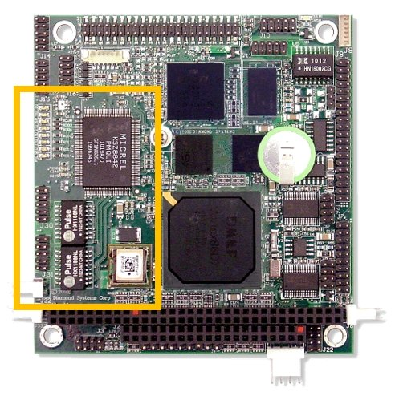
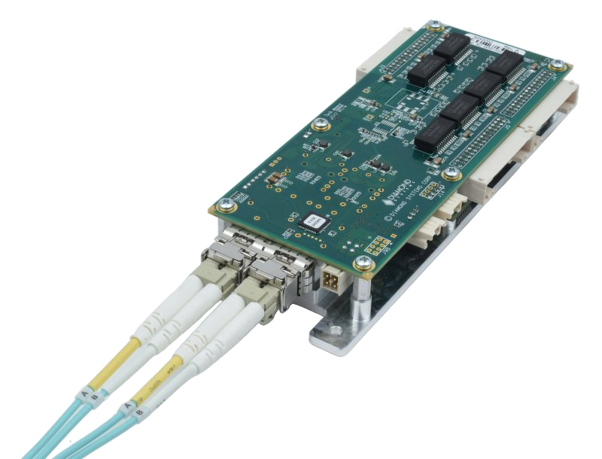
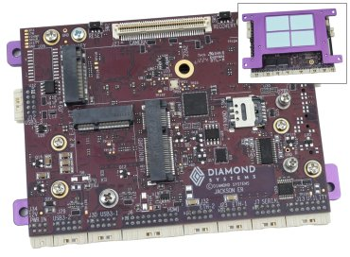
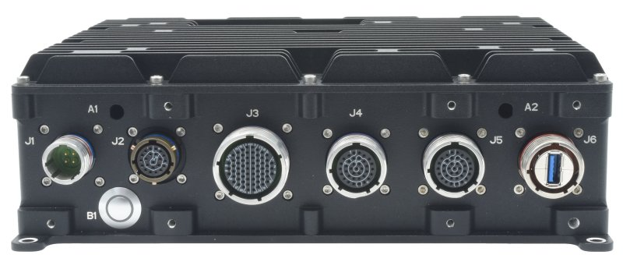
EMBEDDED COMPUTERS
Custom Solutions
Custom Ethernet switch design and manufacturing services are available. Our switch modules speed up the design and delivery of custom switch solutions by significantly reducing the development effort and risk.
Custom Rugged VME SBC
Diamond designed this VME form factor SBC with CAN and MIL-STD-1553 for a military ground vehicle monitoring system to replace another vendor’s product that had become obsolete.
Custom PC/104 SBC
Diamond designed this PC/104 low-power SBC with an integrated Ethernet switch to control lighting in smart buildings.
Discover the full breadth of Diamond’s rugged and I/O-rich embedded computing product line!
Embedded Computer Boards
 | SBCs range from low-end 486 processors up to Core i7 and Xeon. All products are rated -40 to 85ºC. COM-based designs provide performance scalability and extended lifetime. Many SBCs include an on-board professional quality data acquisition system.
Ethernet Switches
 | Ethernet switches range from 8 to 28 ports with a combination of 1G copper and 10G SFP+ sockets. Embedded management software with web and serial command interfaces is included on all products. Boards provide a complete solution on a single board. Modules provide the core technology and embedded software to take the risk and complexity out of designing a custom Ethernet switch solution.
NVIDIA® Jetson
 | NVIDIA® Jetson solutions support the latest generation of Jetson modules and related technologies. Carrier boards feature built-in I/O and expansion sockets Integrated assemblies contain the Jetson module installed and programmed along with a thermal solution Commercial- and military-grade systems are ready-to-deploy complete solutions
Rugged Systems
 | Rugged computers and Ethernet switches provide the ultimate in ruggedness for harsh environment applications. SBCs feature extreme configuration flexibility with COM-based design for performance scalability and extended lifetime plus a multitude of sockets and built-in connectors for easy I/O expansion.
© 2025 Diamond Systems Corp.
www.diamondsystems.com

